Slide 1
Note: please make the background for all these pages white instead of the grey that is currently being used.
Thanks

Slide 2


Slide 3


Slide 4


Slide 5
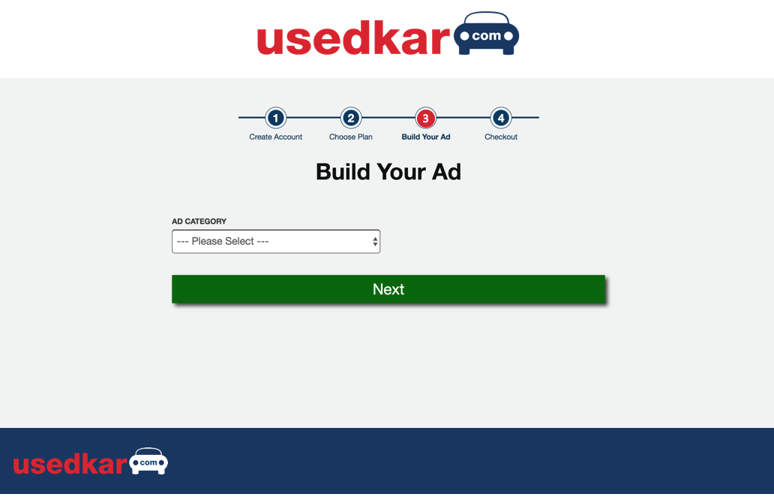

Slide 6
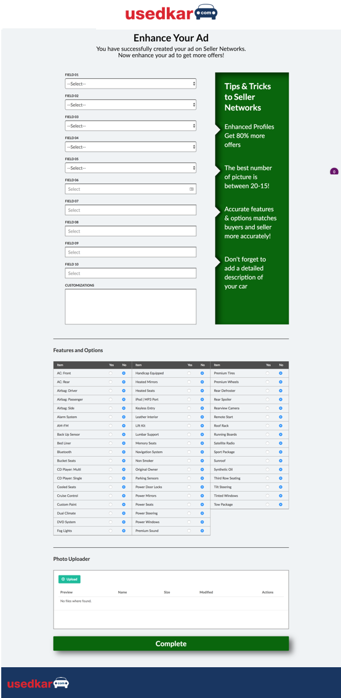

Slide 7


